Slide 1
NLP Deep Dive
AI learning how to read like humans

Slide 2
What is NLP?
From previous lessons, you might have learned that NLP is AI that is trained to understand language.
NLP will allow the AI to break down human text into something the AI can understand

Slide 3
How does NLP Break Down Text?
Tokenization
Noise Removal
Lexicon Normalization
(OPTIONAL)
Part of Speech Tagging
Entity Extraction
Bag of Words/TF-IDF

Slide 4
Tokenization
Input | Output
Sentence Tokenization:
This Agreement will be governed and construed in accordance with the laws of the State of California without giving effect to conflict of laws principles. Both parties submit to personal jurisdiction in California and further agree that any cause of action arising under this Agreement shall be brought in a court in Orange County, California.
“This Agreement will be governed and construed in accordance with the laws of the State of California without giving effect to conflict of laws principles.” “Both parties submit to personal jurisdiction in California and further agree that any cause of action arising under this Agreement shall be brought in a court in Orange County, California”
Sentence tokenization: Breaks down a paragraph into sentence
Word tokenization: Breaks down a sentence into words
Word Tokenization:
“This Agreement will be governed and construed in accordance with the laws of the State of California without giving effect to conflict of laws principles.”,
“This”, “Agreement”, “will”, “be”, “governed”, “and”, “construed”, “in”, “accordance”, “with”, “the”, “State”, “of”, ”California”, “without”, “giving”, “effect”, “to”, “conflict”, “of”, “laws”, “principles”.
Watch how this paragraph gets decomposed.

Slide 5
Word Preprocessing
Input | Output
Noise Removal
“This Agreement will be governed and construed in accordance with the laws of the State of California without giving effect to conflict of laws principles.”,
“This Agreement will be governed and construed in accordance with laws of State of California without giving effect to conflict of laws principles”
Stop Words (Noise words)
Words that have no meaning and only used for human convention
“The”, “a”, “an”, etc. You can choose your stop words list
Lexicon Normalization (word lemming and stemming)
Many words in English have different forms.
This process changes words to their base form
Word Tokenization:
“This Agreement will be governed and construed in accordance with laws of State of California without giving effect to conflict of laws principles”
“This Agreement will be govern and construe in accord with law of state of California without give effect to conflict of law principle” (Highlighted words were lexically normalized)

Slide 6
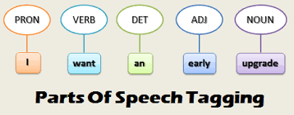

Feature Engineering
Input | Output
Part of Speech Tagging
“This Agreement will be govern and construe in accord with law of state of California without give effect to conflict of law principle”
“N: Agreement, laws, accord, state, California, effect, conflict, laws, principles, giving V: will, be, govern, construe Det: This, and, in, with, the, of, the, of, without, to, of
Part of Speech Tagging
Every word gets a tag corresponding to its part of speech
Helps AI group words together
Entity Extraction
Words are grouped based on predefined categories
Entity Extraction
“This Agreement will be govern and construe in accord with law of state of California without give effect to conflict of law principle”
Item: Agreement Location: State of California

Slide 7
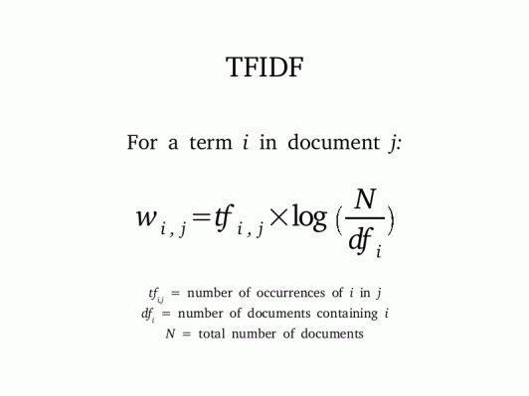
Statistics
Bag of Words
Keeps track of the number of times a word shows up in a sentence
TF-IDF (Term Frequency - Inverse Document Frequency)
Similar to Bag of words
Uses a formula to measure relevance
Higher TF - IDF number = more relevance to document.
More unique words.
Note: This is log base 2

Slide 8
Bag of Words example
Clause 1: Laws State New York govern matter arise relate Agreement.
Clause 2: Agreement governed internal law, not law regard conflict law, State North Carolina
Clause 3: Agreement governed construed accordance with laws State California without giving effect conflict laws principles
 | agreement | govern | law | state | matter | principles | regard | conflict | relate | etc.
C1 | 1 | 1 | 1 | 1 | 1 | 0 | 0 | 0 | 1
C2 | 1 | 1 | 1 | 1 | 0 | 0 | 1 | 1 | 0
C3 | 1 | 1 | 1 | 1 | 0 | 1 | 0 | 0 | 0

Slide 9
TF-IDF
Clause 1: Laws State New York govern matter arise relate Agreement.
Clause 2: Agreement governed internal law, not law regard conflict law, State North Carolina
Clause 3: Agreement governed construed accordance with laws State California without giving effect conflict laws principles
0.477 is a high number. In this case, the word “matter” is more relevant and unique to Clause 1.
 | agreement | govern | law | state | matter | principles | regard | conflict | relate | etc.
C1 | 0 | 0 | 0 | 0 | 0.477 | 0 | 0 | 0 | 0.477
C2 | 0 | 0 | 0 | 0 | 0 | 0 | 0.477 | 0.477 | 0
C3 | 0 | 0 | 0 | 0 | 0 | 0.477 | 0 | 0 | 0

Slide 10
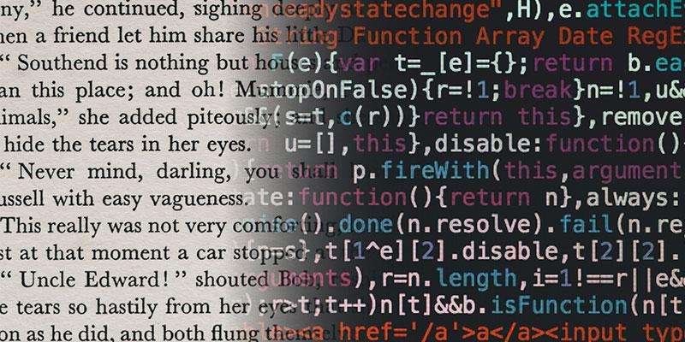
Identification
Given that Clause 1 and 2 are governing law clauses, the AI would think that:
“California”, “North Carolina”, and “New York” are all locations (Entity Extraction)
The first four words have a low TF-IDF score, meaning they are shared across many documents. This means the words appear in documents like those(TF-IDF)
There is usually a word which is a location, and it is usually the answer.
So, the AI would say that Clause 3 is a governing law clause, and that the answer is “California”

